Slide 1
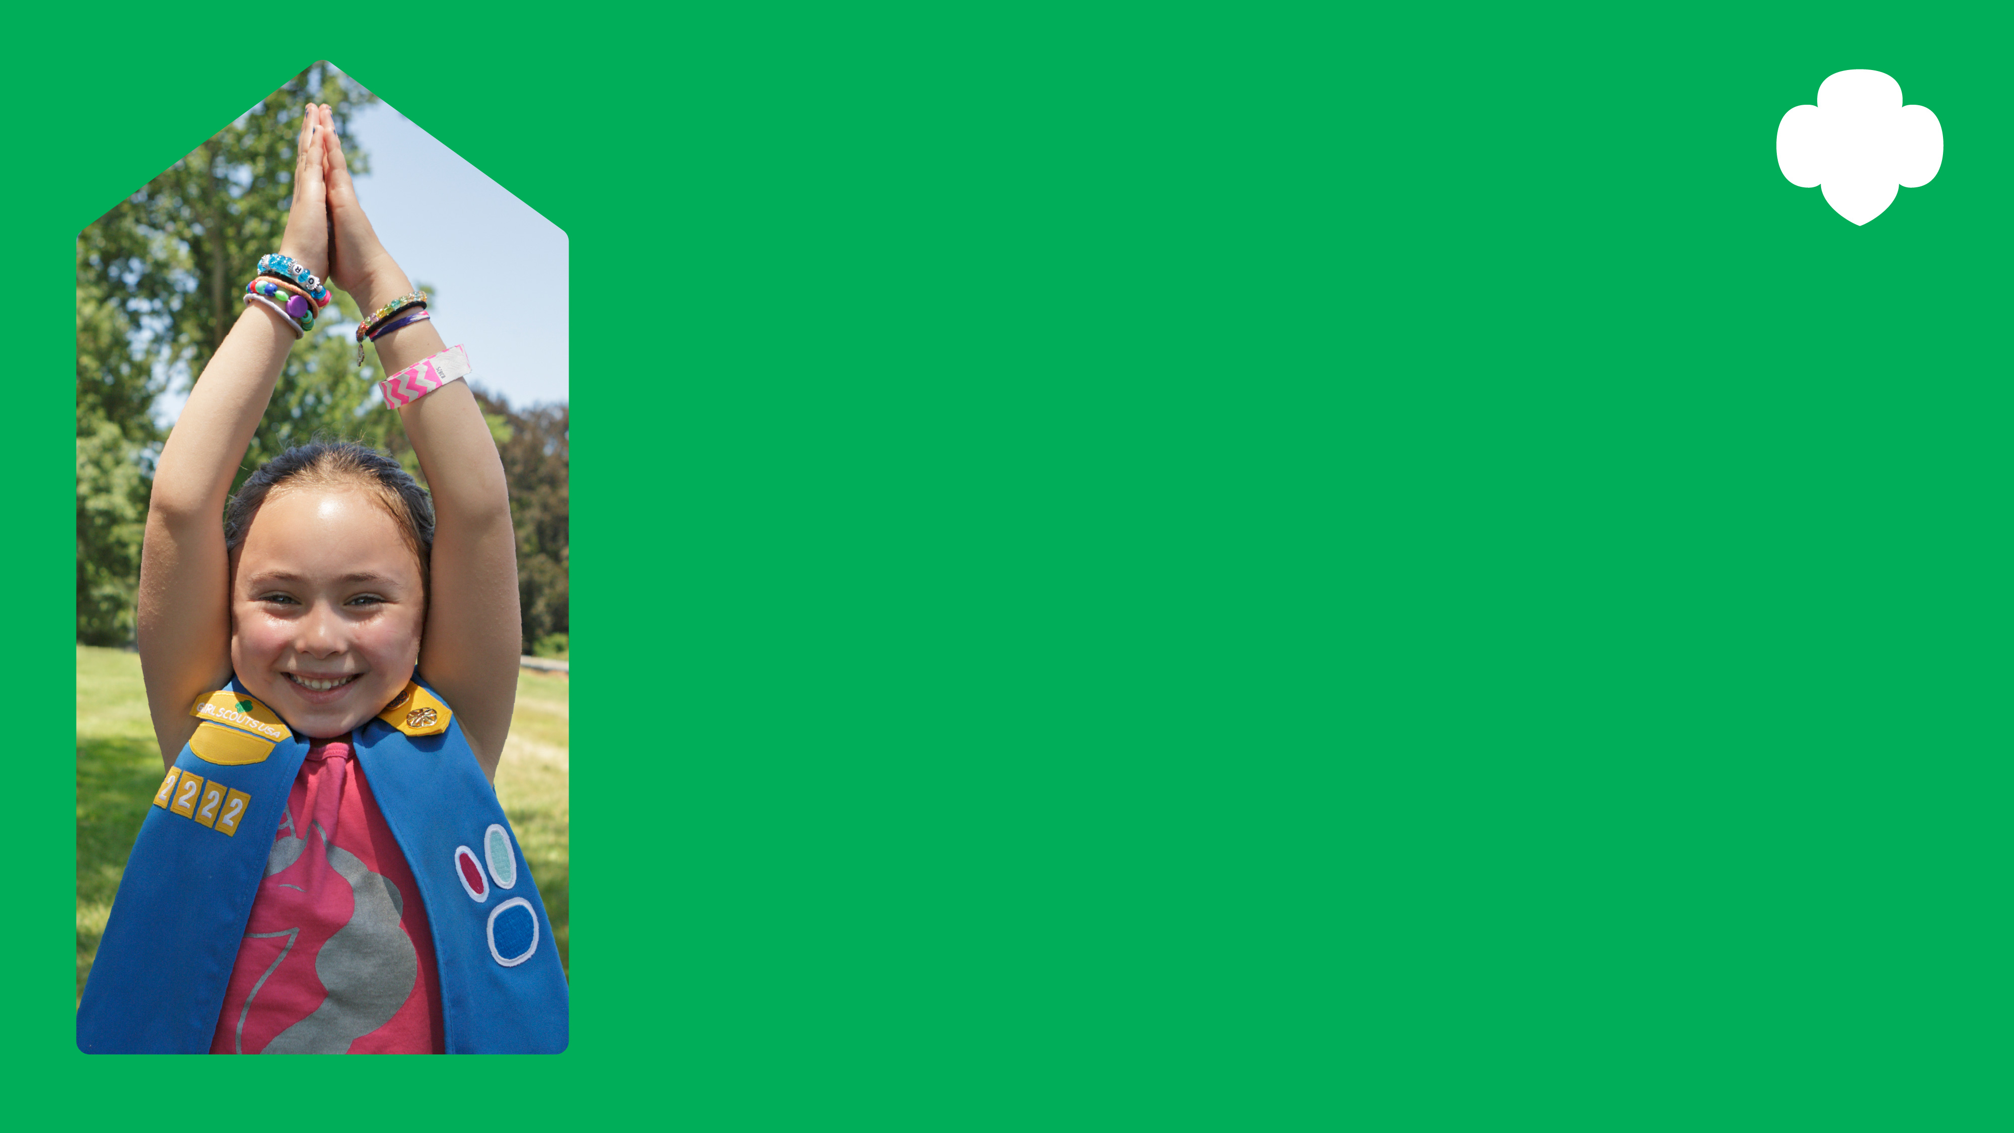
Girl Scout Sunday
Celebrating the powerful ties between Girl Scouting and faith. Honoring Girl Scouts and volunteers who make our world a better place.
Join us on [EVENT DATE, time]. Visit us at [COUNCIL SITE] for more info.

Slide 2
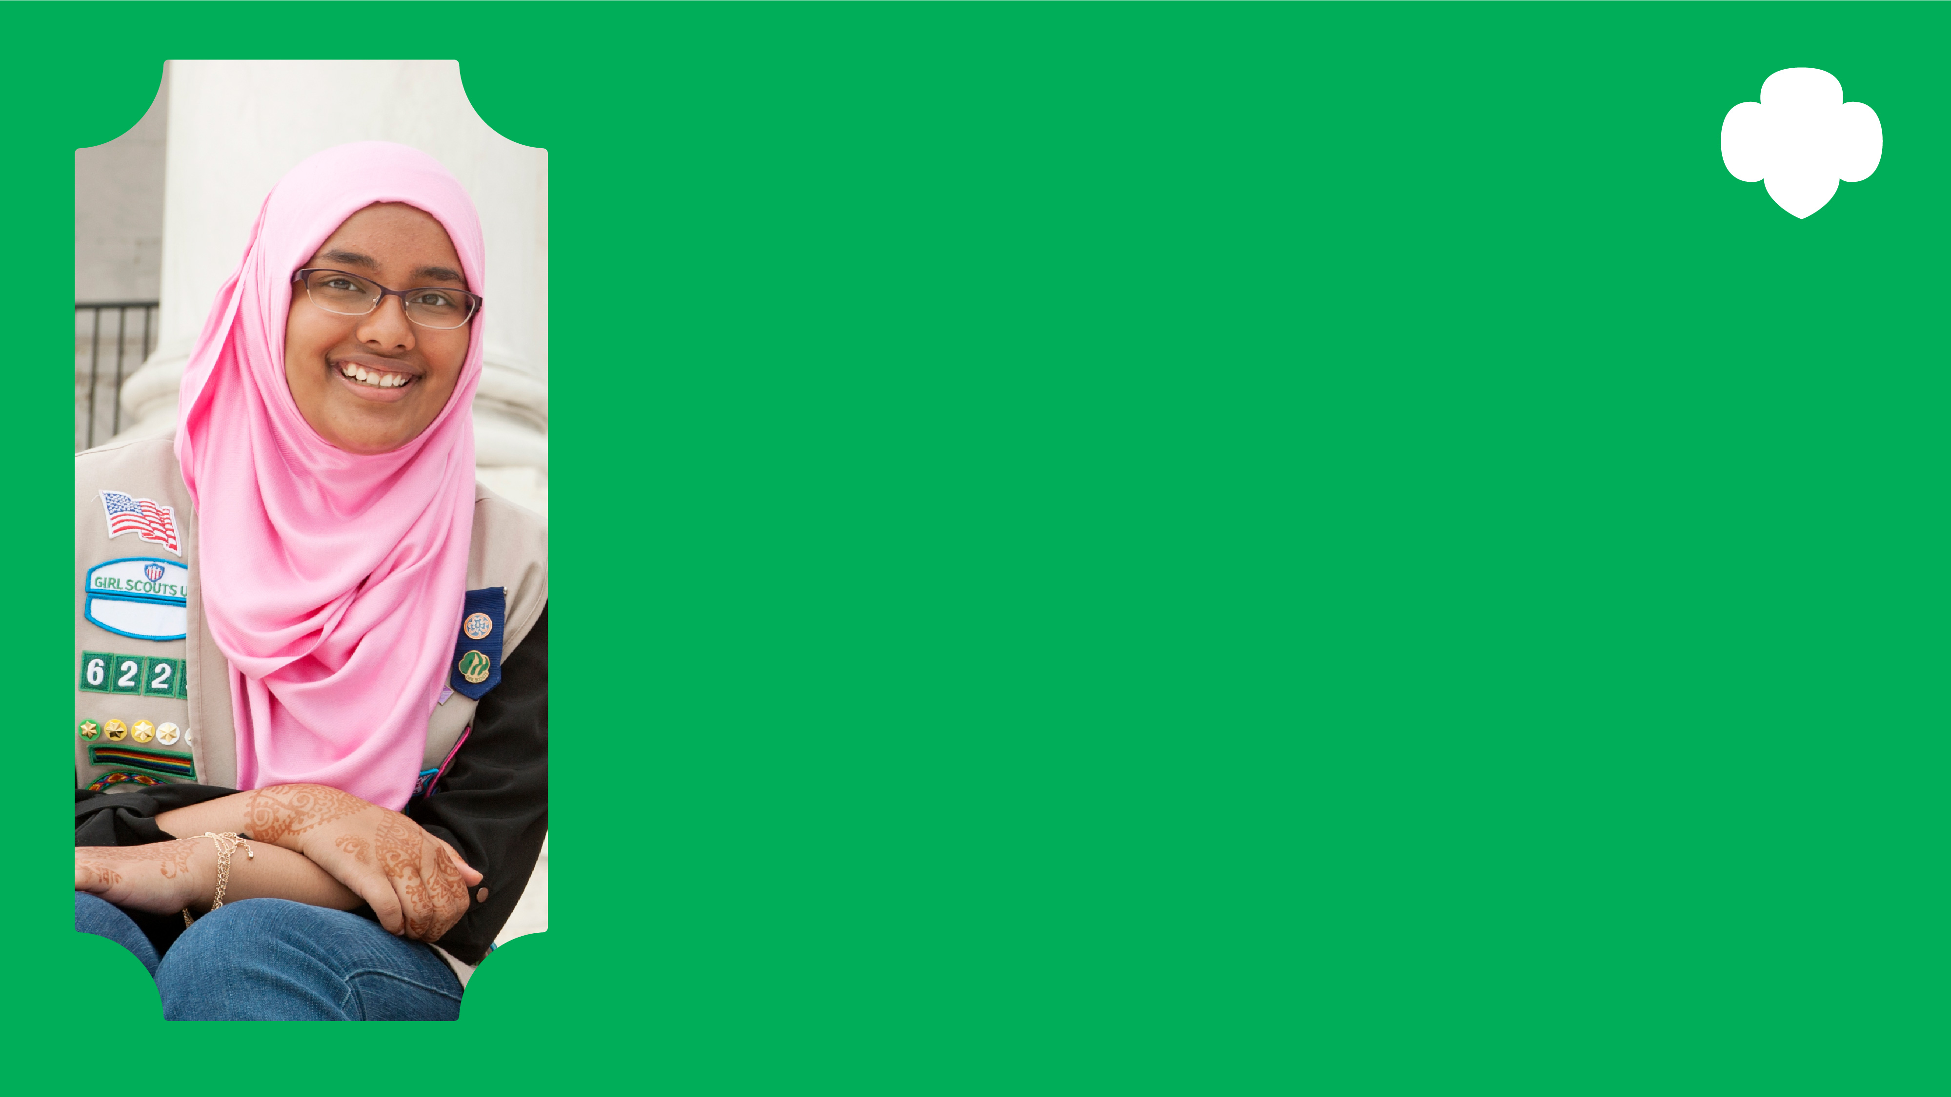
Girl Scout Jummah
Celebrating the powerful ties between Girl Scouting and faith. Honoring Girl Scouts and volunteers who make our world a better place.
Join us on [EVENT DATE, time]. Visit us at [COUNCIL SITE] for more info.

Slide 3
Girl Scout Sabbath
Celebrating the powerful ties between Girl Scouting and faith. Honoring Girl Scouts and volunteers who make our world a better place.
Join us on [EVENT DATE, time]. Visit us at [COUNCIL SITE] for more info.

Slide 4
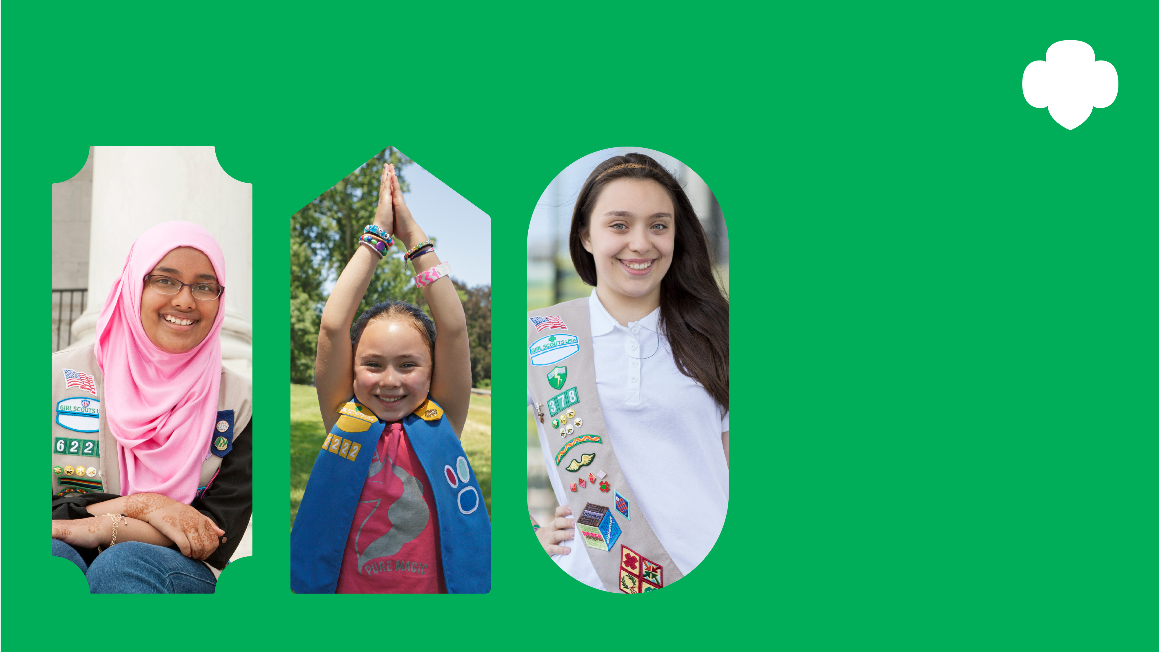
Girl Scouts Celebrate Faith
Celebrating the powerful ties between Girl Scouting and faith. Honoring Girl Scouts and volunteers who make our world a better place.
Join us on [EVENT DATE, time]. Visit us at [COUNCIL SITE] for more info.

